Slide 1
Activity 1

Slide 2
1 | Import the Business data file into Microsoft Power BI.
2 | Load only the “Account” sheet from the workbook after transforming the data.
3 | Represent the data as per the given criteria: Represent the data, which includes the total count of account numbers against the country, in a tabular format. Insert another table and represent the data on the country-wise Account holder's name. Insert a slicer from the visualisation section and add a country-wise filter. Represent the data of India, Brazil, Greece, and France together.

Slide 3
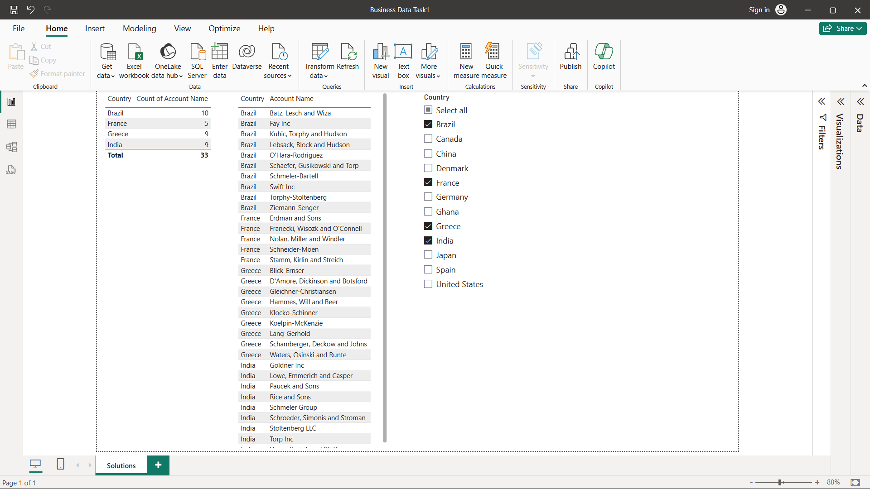

Slide 4
1 | Add a page into Power BI and import the worksheets named Accounts, Industry & Opportunities from the same Business data file.
2 | Represent the data as per the given criteria: Country-wise industry and average profitability margin (in Percentage %) Add a separate filter so that country-wise industry and profitability margins can be shown based on the selective countries (There is no bar on country selection).
3 | Represent the following data using a pie chart: Industry-wise profitability percentage The data should be visualised in single or multiple country-wise
4 | Present the data that shows industry-wise profitability trends by taking the Line & stacked column chart.
5 | Present the data to show country-wise industry market values and industry-wise presence by taking the map chart.

Slide 5
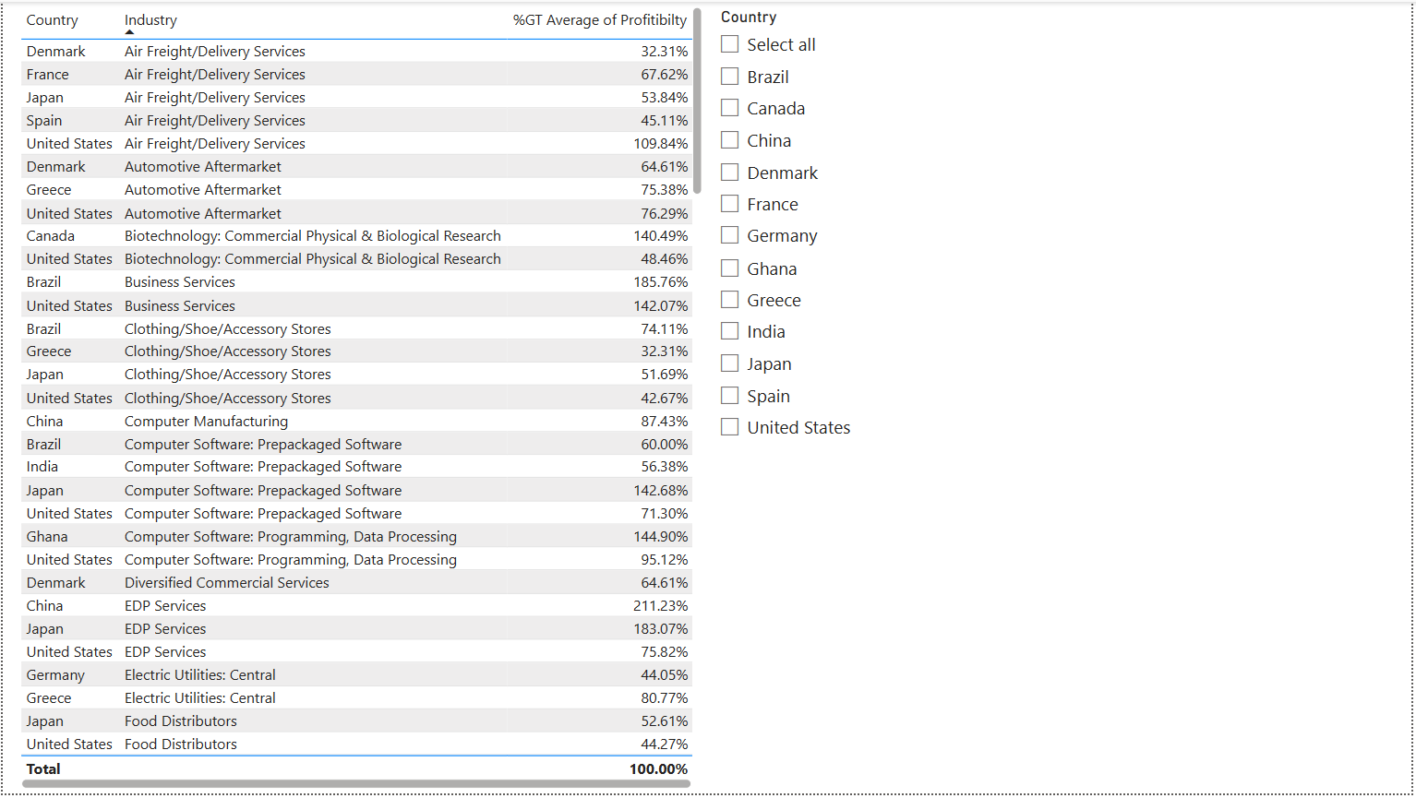

Slide 6
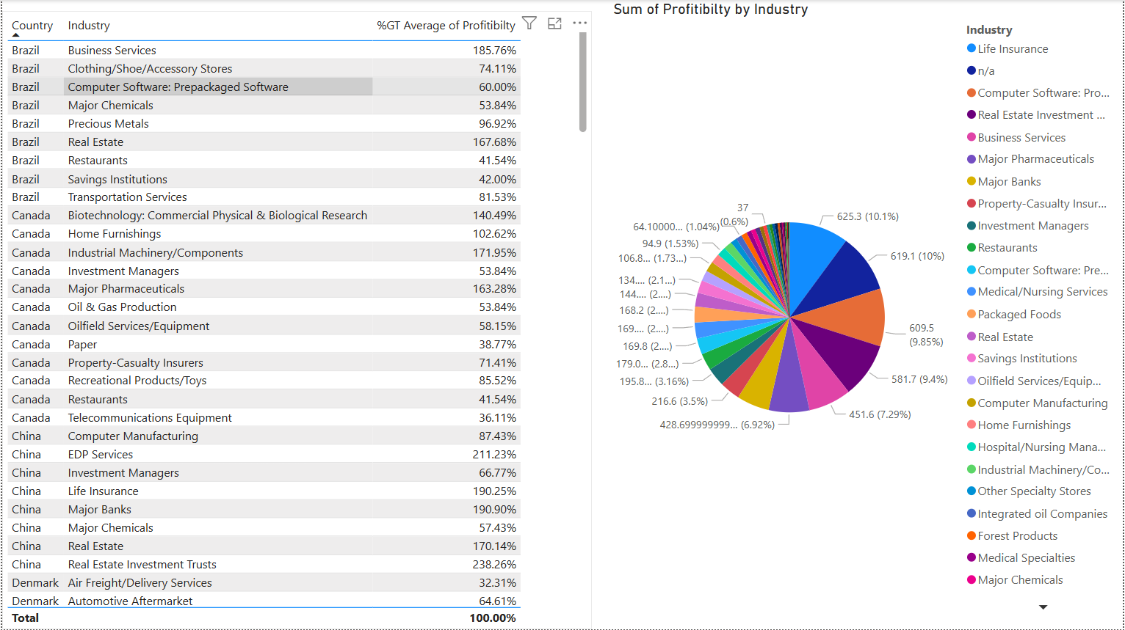

Slide 7
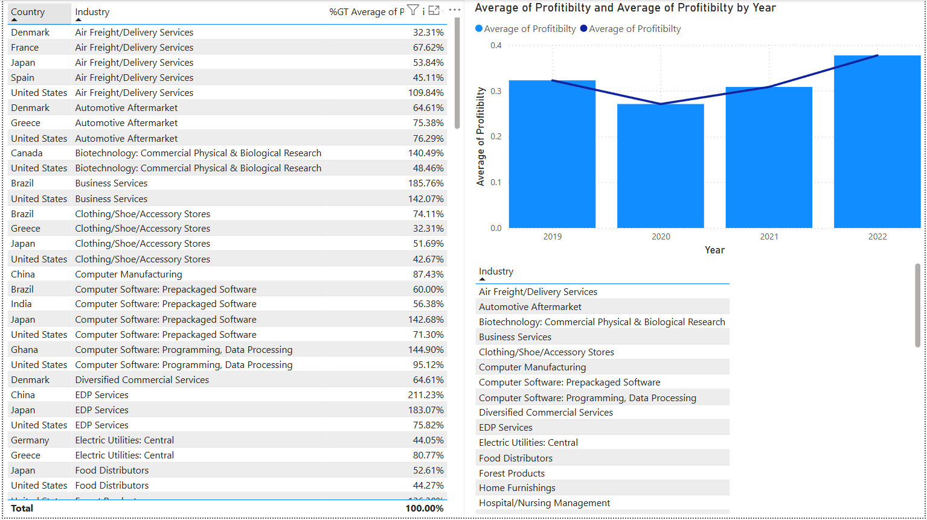

Slide 8
